Slide 1

Predicting Marketing Response Rates
Thinkful Data Science Mid-Capstone
Roy Shabaya

Slide 2
Introduction
Data
Marketing response data obtained from UCI Machine Learning Repository - from a Portuguese bank using telemarketing to offer their customers a term deposit product
Data includes demographic information on the customer, the banks information on the campaign, as well as macro-economic data
Research Topic: Can we predict whether a customer will purchase the product, given demographic and campaign data.
Purpose: Being able to predict a customers response to a marketing campaign can help a company maximize their marketing efforts

Slide 3
Data Exploration – Initial Insights
Baseline 88.8% of the data is from the majority class, customers that did not make a purchase
There are 41,188 observations, across 21 features
3 Sections of Data:
Customer – Age, Job, Marital, Education, Housing, etc. (1/7 continuous)
Campaign – Number of contacts, day of week, duration, previous outcomes (4/9 Continuous)
Macro Economic – CPI, Employment variation rate, CCI, Number of employees( 4/4 continuous)

Slide 4
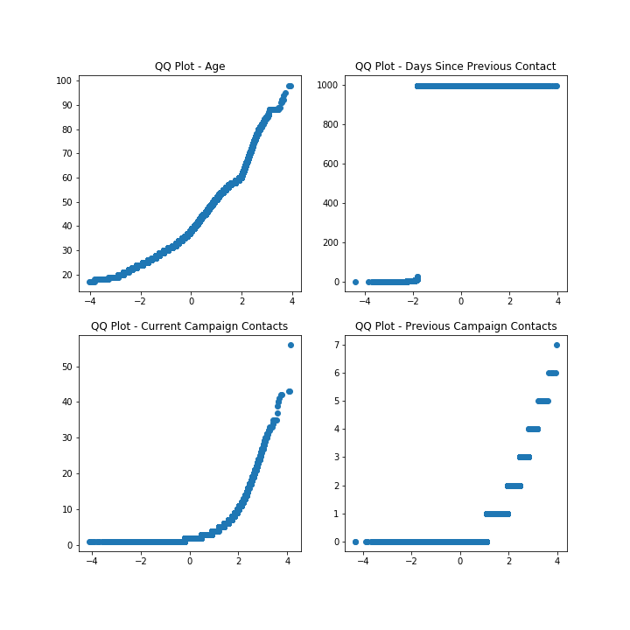
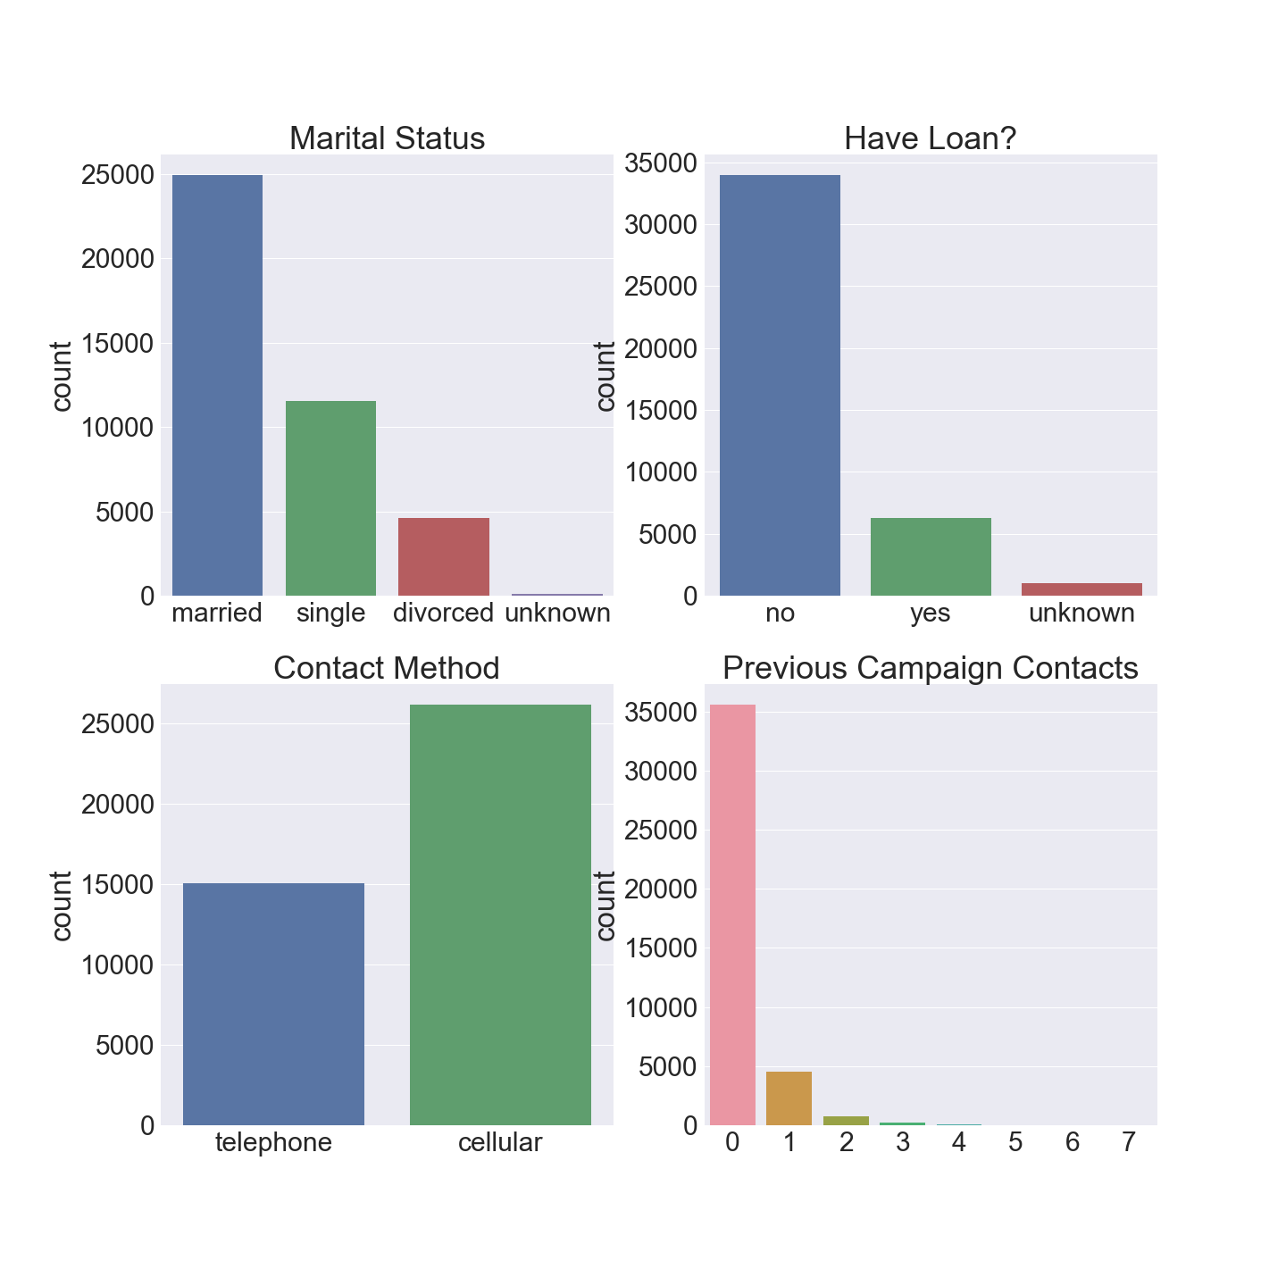
Exploring the Data…
Numerical
Categorical

Slide 5
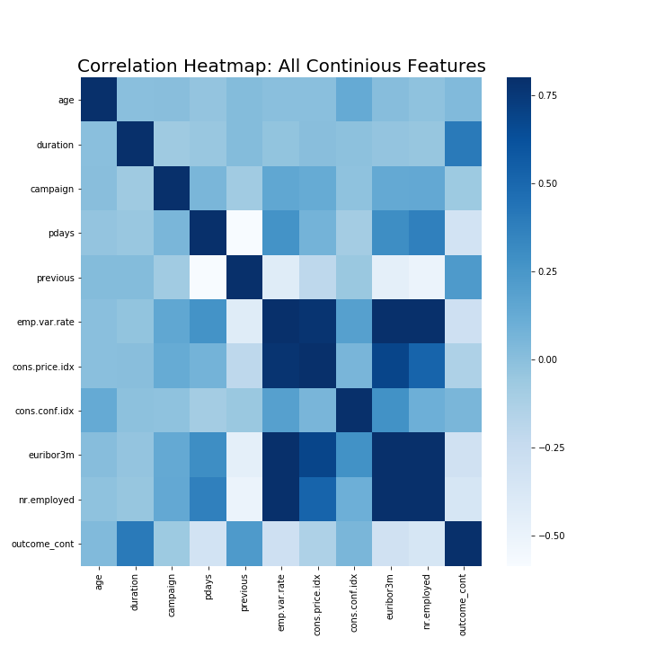
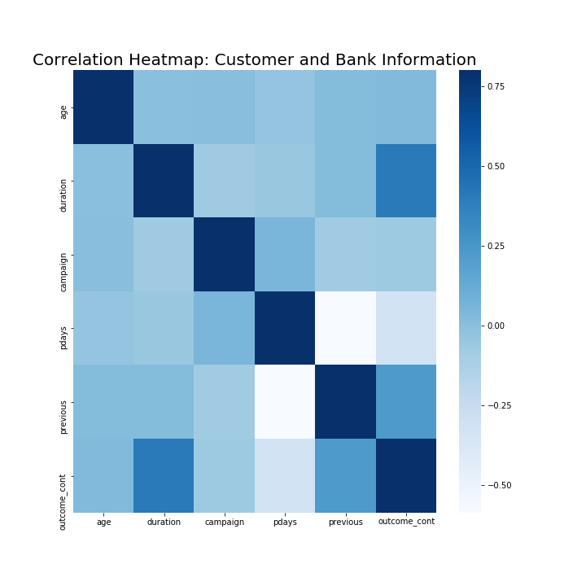
Feature Correlation
Looking a the full data set we can see high correlation between the macroeconomic features.
Looking only at the bank and customer information there aren’t any worrying correlations between the features. We do notice a correlation between duration and the target outcome.. Unfortunately that can’t be used since we will not know the duration beforehand.

Slide 6
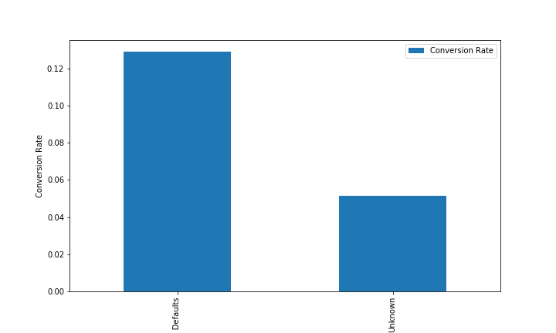
Conversion Rate : Past Defaults

Slide 7
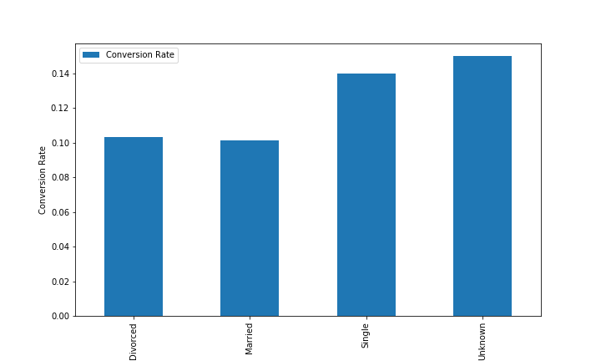
Conversion Rate : Marital Status

Slide 8
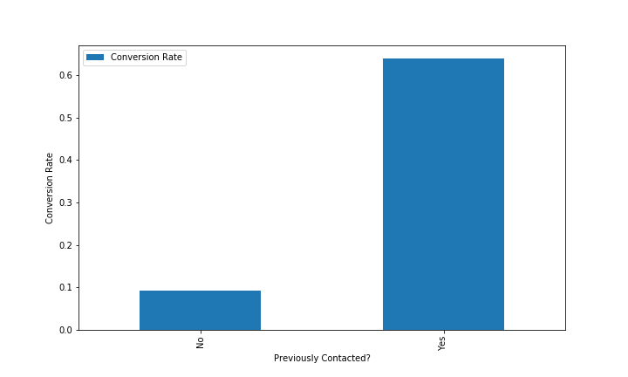
Conversion Rate :

Slide 9
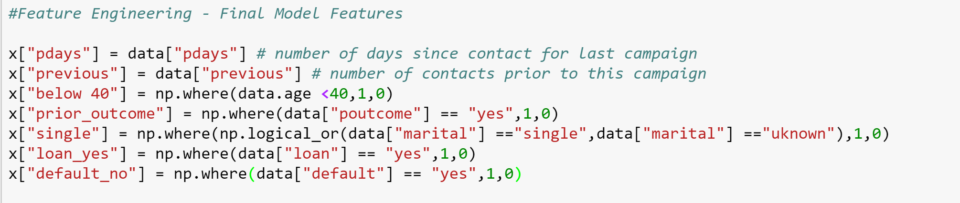
Feature Engineering
Created features based on insights learned from exploration
Most of the customer and bank data was categorical – created dummy features
Attempted to identify interactions, as well as whether transformations would help performance
Transformed several continuous variables to categorical

Slide 10
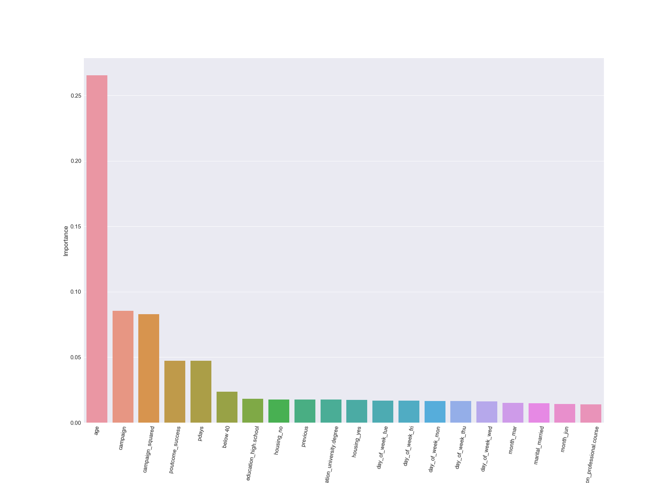
Feature Selection
Several methods were used for feature selection:
Coefficients from Lasso
PCA
Random Forest Feature Importance
Backwards Pass Feature Elimination
RFE
Conclusion – Most features don’t improve model

Slide 11

Measuring Model Performance
Sensitivity
Specificity
Probability that positive examples will be correctly identified
Customer making a purchase is our positive
Probability that negative examples will be correctly identified
Customers that don’t make a purchase are the negative
Score
Mean accuracy of the overall model
Built in method for all models

Slide 12
Modeling
Models
Model | Train Score | Test Score | Sensitivity | Specificity
KNN | 0.8985 | 0.8963 | 0.9874 | 0.1944
Boosted Model | 0.9002 | 0.8954 | 0.9871 | 0.1893
Standard Logistic | 0.8983 | 0.8953 | 0.9844 | 0.2088
Support Vector | 0.8983 | 0.8953 | 0.9844 | 0.2088
Random Forest | 0.9013 | 0.8953 | 0.9884 | 0.1784
Lasso Regression | 0.8221 | 0.8214 | 0.8878 | 0.3102
Ridge Regression | 0.8221 | 0.8214 | 0.8878 | 0.3102

Slide 13
Random Forest
Overview
Parameters & Results
Pros:
Less likely to overfitting than decision trees
Help understand feature importance
Resistant to outliers
Doesn’t require input preparation(can handle numerical, binary, and categorical without scaling transformation or modification)
Cons:
Difficult to interpret
Larger forests can be slow to run

Slide 14
Logistic Regression
Overview
Parameters & Results
Pros:
Easy to interpret
Lasso – Zeros coefficients/feature selection
Ridge – Minimizes coefficients
Cons:
Needs independent observations
Requires large data set to achieve stable results

Slide 15
Support Vector
Overview
Parameters & Results
Pros:
Very accurate
Can model complex, nonlinear relationships
Deals with noise well
Cons:
Computationally demanding
Hard to interpret
Picking right kernel is key – in comparison to Random Forest, etc.

Slide 16
Gradient Boosted Model
Overview
Pros:
Feature transformation not needed
Automatically handles missing values
Feature selection is part of model process
Cons:
Difficult to interpret
Can be computationally intensive with larger number of estimators
Sensitive to noisy data and outliers*
Parameter tuning essential, may not work well otherwise

Slide 17
KNN
Overview
Parameters & Results
Pros:
Really simple and fast training
Feature selection part of model
Handles multiclass problems well
Cons:
Lazy learner – uses training data for classification
Can be slow during prediction

Slide 18
Future Work
Attempt to obtain more data to help build improved models

Slide 19
Conclusions

Slide 20
Thank You!

